Slide 1
1. “Kit Qty” for orders with accessories only
Focused orders
WMS orders with only 1 accessory SKU. Example: WMS 7673
How to confirm whether it’s an accessory SKU? - Refer to Excel attached. SKU is considered as accessory if it is included.
Affected Reports
CODE – KPI – Outbound KPI
CODE – Billing Report – Outgoing Order Detail
Current
Kit Qty = 0
Expected
Kit Qty = 3
3
Calculation: 50 (Qty) / 20 (Qty/Kit) = 3 (2.5 round up)
Please round up all decimal numbers.
(In Excel file attached)

Slide 2
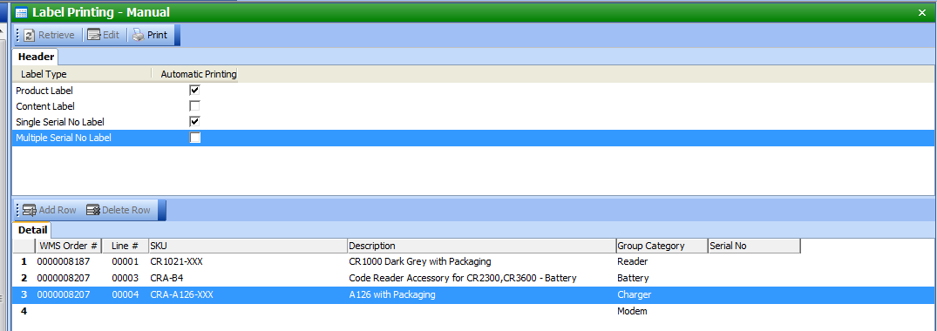
2. Eliminate duplicated selection for same orders
Focused orders
Cortex orders
Current
We need to select correct WMS number from all on-going WMS numbers for Cortex
Once we finished the 1st kit, click print, all information will be erased
We need to select again for the 2nd kit, and repeat until all kits are scanned and printed. Please imagine we have a 500 kits order ☹
Expected:
We manually select necessary information once.
Option 1: System automatically copy those information to all kits under same order.
Option 2: System keep all information except serial numbers after clicking print.

